Slide 1
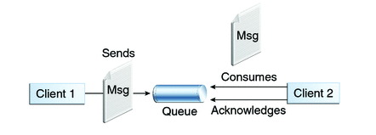

Spring + JMS + ActiveMQ Example with Annotations [Send/Receive Product Object]
Queues [point-to-point]: Queue’s are based on point-to-point messaging model where messages are sent to a queue. Each message has exactly one sender and one receiver. Message is guaranteed to be delivered to only one receiver.
MessageProducerApp.java
MessageConsumerApp.java

Slide 2
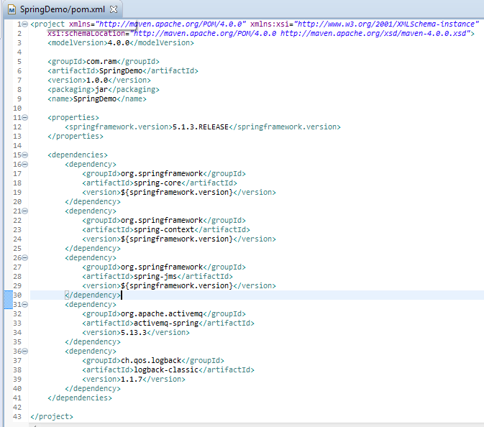
Spring + JMS + ActiveMQ Example with Annotations [Send/Receive Product Object]

Slide 3
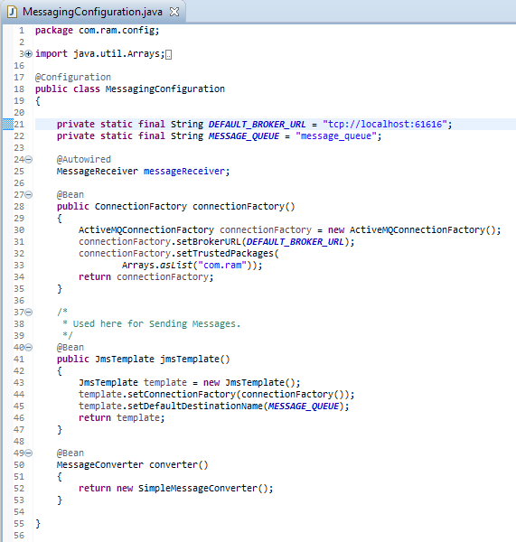
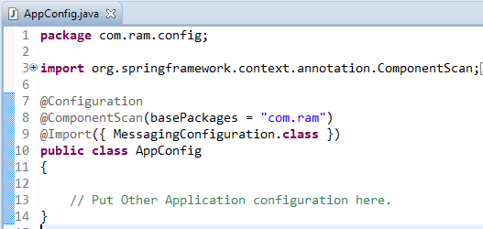
Spring + JMS + ActiveMQ Example with Annotations [Send/Receive Product Object]
JmsTemplate : JmsTemplate provides an abstraction which hides all the complexities of JMS communication.
Without JmsTemplate, you will be forced to create connections/sessions/MessageProducers/MessageConsumers and catch all the nasty exception platform may throw.
With JmsTemplate ,you get simple API’s to work with , and spring behind-the-scenes take care of all the JMS complexities. It takes care of creating a connection, obtaining a session, and finally sending [as well as synchronous receiving] of message. We will be using JmsTemplate for sending the message.
Do note that JmsTemplate also provides possibilities for receiving message but that is synchronous[blocks the listening application], and usually not preferred when asynchronous communication is possible.

Slide 4
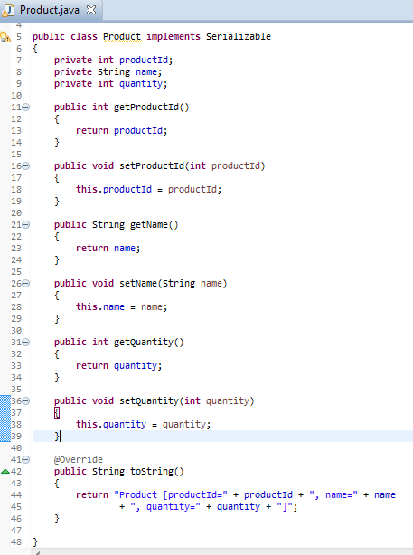
Spring + JMS + ActiveMQ Example with Annotations [Send/Receive Product Object]

Slide 5
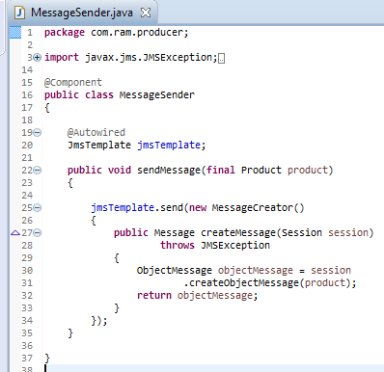
Spring + JMS + ActiveMQ Example with Annotations [Send/Receive Product Object]

Slide 6
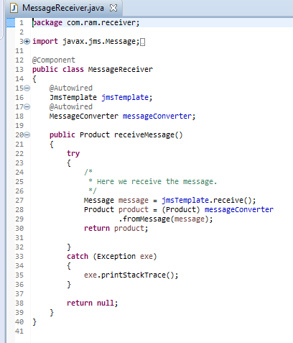
Spring + JMS + ActiveMQ Example with Annotations [Send/Receive Product Object]
MessageConverter: Spring further helps us by providing converters which convert Java objects to JMS messages and viceversa.

Slide 7
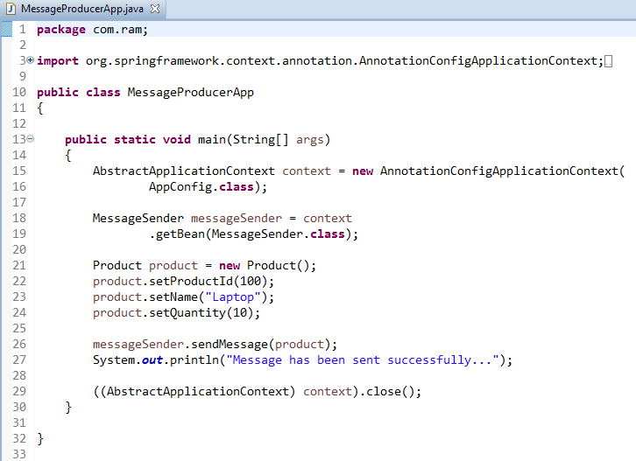
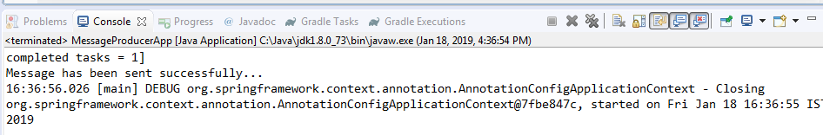
Spring + JMS + ActiveMQ Example with Annotations [Send/Receive Product Object]

Slide 8
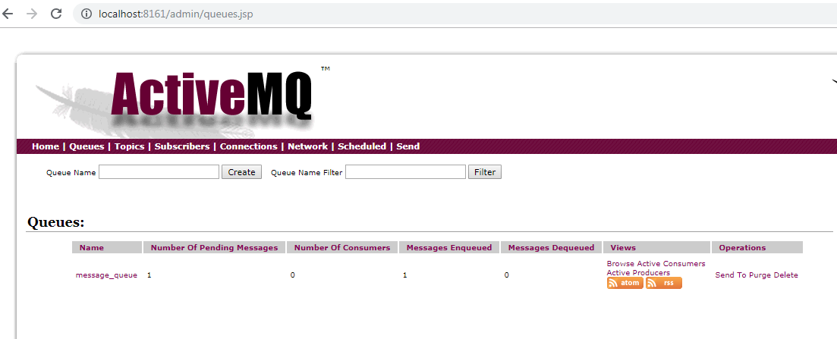
Spring + JMS + ActiveMQ Example with Annotations [Send/Receive Product Object]

Slide 9
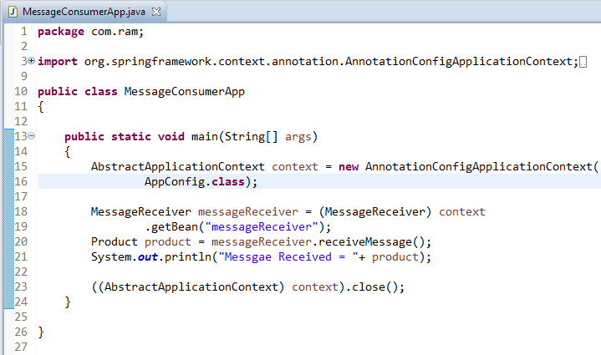
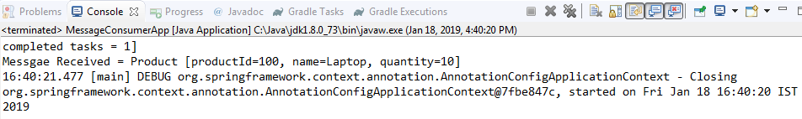
Spring + JMS + ActiveMQ Example with Annotations [Send/Receive Product Object]

Slide 10
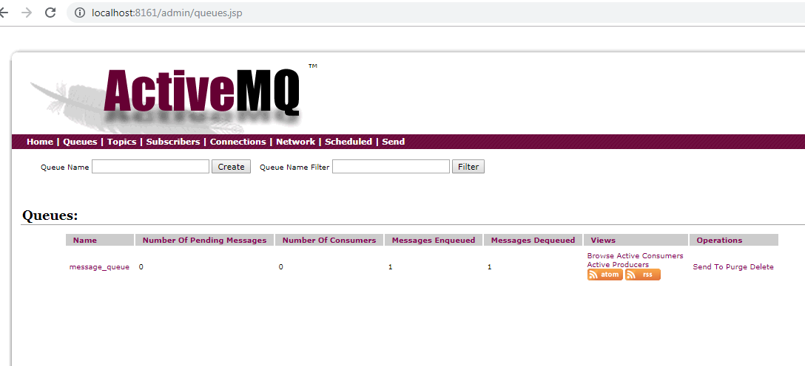
Spring + JMS + ActiveMQ Example with Annotations [Send/Receive Product Object]

